Slide 1
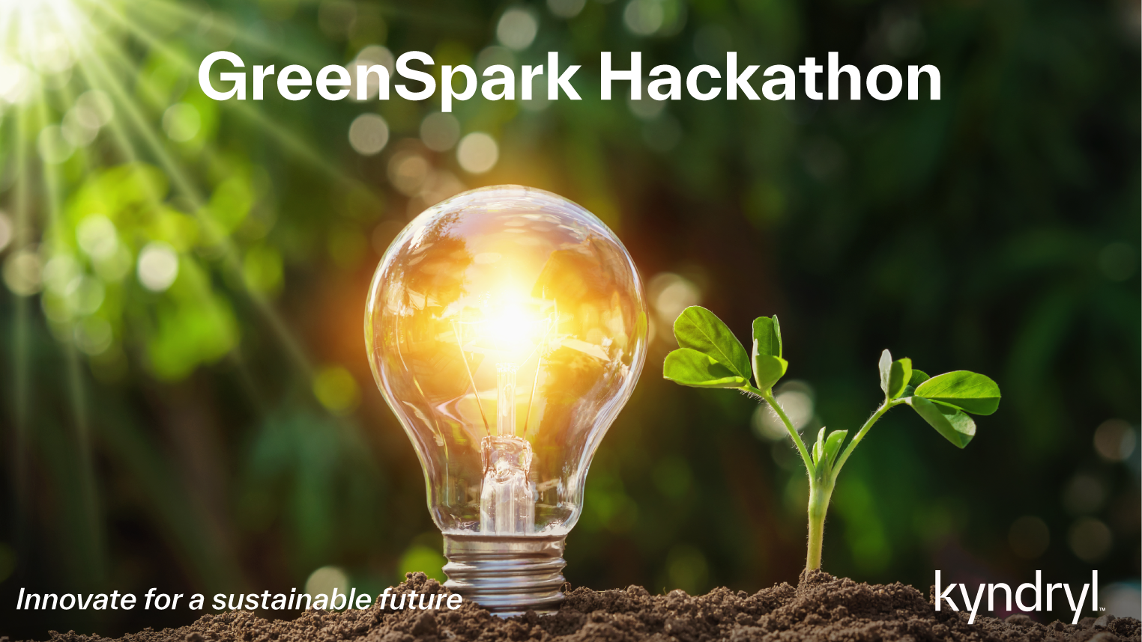
Add quote or statement here
- Name Last
EcoVision - Phase 2

Slide 2



EcoVision - Team Intro
Kyndryl
Iwona Kwiek
Kannika Kabilar
Adrianna Kocyba-Kostecka
Pedro Soares
Praveen Kumar Madhava Rao
Dominika Fargasova
Chandan Bhat
BhavyaShree Mucherla
Kavitha Sureshkumar
Kavya Singh

Slide 3
EcoVision - Goal
To Optimize/Minimize The Carbon Footprint Throughout The Software Development Lifecycle
Plugin with IDE to enables Developers to write a more efficient code by providing recommendation (Phase 1)
Integrate with the CI/CD pipeline to continuously measure and reduce the environmental impact of our code (Phase 2)
3
3

Slide 4





























































Ways EcoVision Can Maximize Our Investments
Internal Developer Platform
Developer
Control
Plane
z
Developer Portal
IDE
Customer Zero
Kyndryl IDP (internal)
Customer One
Jain University
Version Control & Collab
EcoVision
Integration
& Delivery
Plane
Resource Plane
CICD Pipeline
Tests
Registry
Compute
EcoVision
Data
Networking
Monitoring & Logging
Plane
Observability
TSAM
DevOps Intelligence
Services
Security Plane
Secrets & IAM

Slide 5
Novelty
Prior Art
EcoVision
US20210373973
“Workload Placement Based On Carbon Emissions”
EcoVision enables developers
To write more efficient code by providing recommendations within IDE through a lightweight plugin empowered by AI/ML
To enable measuring the Carbon emission and environmental impact continuously through integration with CI/CD Pipeline.
→ Enables to choose right target environment with lowest carbon emission cost and execute the workload.
1
US20230229413
“Intelligent management of software deployment based on code change”
EcoVision enables
Identifying required pipeline stages in the DevOps pipeline based on the code change
Facilitates to skip the unwanted stages based on the code change
Measures and estimates the carbon footprint and energy saved by skipping the unwanted stages.
2
→ Enables an efficient deployment based on the code changes, by generating a deployment script.
US10565093
“Providing cognitive intelligence across continuous delivery pipeline data”
EcoVision provides
Recommendations to the developers to enable them write more efficient code that would minimize the environmental impact
Enables to save energy by skipping the unwanted stages based on the code change in a DevOps pipeline
3
→ Prevents potential failures in the continuous delivery pipeline by mapping the changed portion of code with log file(s).
.
US10902484B1
“System and method for carbon footprint determination”
EcoVision provides
Estimates the carbon emission for the execution is each DevOps pipeline stage
Helps saving carbon emission by identifying and skipping the unwanted stages based on the code change.
4
→ Determine the carbon emissions impact for each transaction and displays to user and to merchant.
5
5

Slide 6














How EcoVision looks like?
Code </>
Users (DevOps)
Code Repository
PR Merge
CI/CD Pipeline
------- Run Without EcoVision (Run0) ------
With EcoVision (Run1 & Run2)
Config File
Secret-Scan
Static-Scan
Image Scan
License Check
Unit Test
Build
Deploy
Push to DI
Run1
EcoVision
Secret-Scan
Static-Scan
Image Scan
License Check
Push to DI
Plan
Unit Test
Build
Deploy
Feedback
Run 2
Pipeline Stages Skipped
Pipeline Stages Skipped
Secret-Scan
Static-Scan
Image Scan
License Check
Unit Test
Build
Deploy
Push to DI
Pipeline Stages Skipped

Slide 7
EcoVision - Data Gathering and Carbon Saving Calculation (Sample Flow)
Energy usage without EcoVision
Secret Scan
Static Scan
Unit Test
Build
Image Scan
License Check
Deploy
Sever Config
300 Watts
(4core/16 GB)
300 Watts
(4core/16 GB)
300 Watts
(4core/16 GB)
300 Watts
(4core/16 GB)
300 Watts
(4core/16 GB)
300 Watts
(4core/16 GB)
300 Watts
(4core/16 GB)
Avg CPU Utilization
50%
50%
50%
50%
50%
50%
50%
Uptime/Runtime
5 Sec
24 Sec
31 Sec
16 Sec
10 Sec
31 Sec
10 Sec
= 2250
= 10800
= 13950
= 7200
= 4500
= 13950
= 4500
Total Energy Consumption = 57150 kWh

Slide 8
EcoVision - Data Gathering and Carbon Saving Calculation (Sample Flow)
Carbon Saving Calculation
Estimated kWh =
Compute Watt-Hours * PUE( constant 1.5) * Replication Factor (1)
Energy consumption Without EcoVision
Run 0 | 57150 kWh | 0 stages skipped
Compute Watt-Hours=
Average Watts * Uptime or Time taken to execute the specific pipeline stage
With EcoVision
Run 1 | 25650 kWh | 4/8 stages skipped
Run 2 | 44100 kWh | 2/8 stages skipped
Average Watts =
Based Server Config (Hyper scalar vendor provided data can be considered)
Total CO2e = Operational Emissions + Embodied Emissions
Operational emissions = Compute emission + Memory emission + I/O emission
Average Watts = Derived based on server config and average CPU utilization Compute Watt-Hours = Average Watts * CPU Hours (uptime) Estimated kWh = compute Watt hours * PUE * replication factor Operational emissions = Estimated kwh * Emission factor
PUE = consider as 1.5 for now Replication factor = consider it as 1 Emission factor = based on region
CPU Hours = assume its 24 (in general) Avg Watts = Based on Avg CPU Util & Server Config Memory and I/O emission - ignore for now

Slide 9
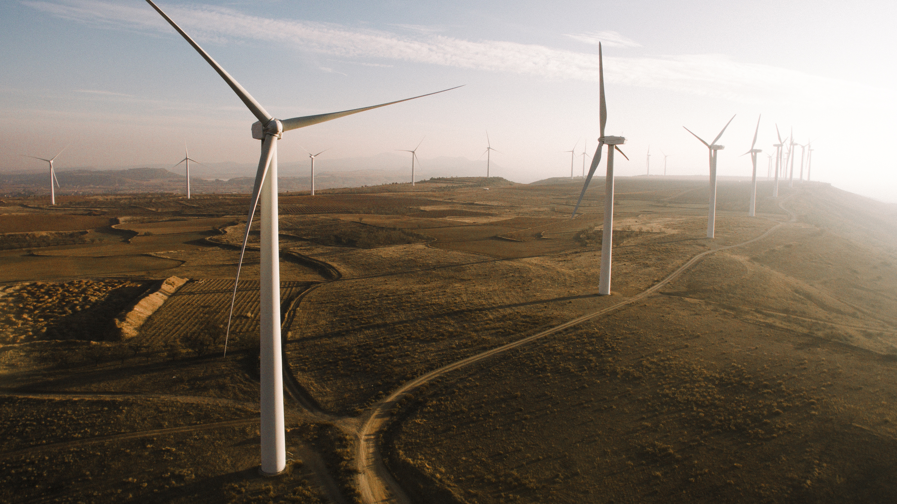
Working Demo – Phase 2

Slide 10

Energy Savings at Org level per Day
Total #DevOps Pipeline | 100
Approx Energy Consumption per pipe (kwh) | 60,000
Total Energy consumption (kwh) | 6,000,000
Avg Energy Saving of 20% (in kwh) | 1,200,000
Estimated Org level Energy saving per month (kwh) | 36,000,000
----------
THANK YOU
EcoVision
Erasing Carbon Footprint One Pipeline at a time

Slide 11
Backup Slides

Slide 12
Ways EcoVision addresses hackathon’s theme #1 objectives
01
02
Measures Carbon footprint of the software
Enable developers write more efficient code
03
04
Can be easily integrated into CI/CD Pipeline
Continuously measures and reduces environmental impact of our code

Slide 13




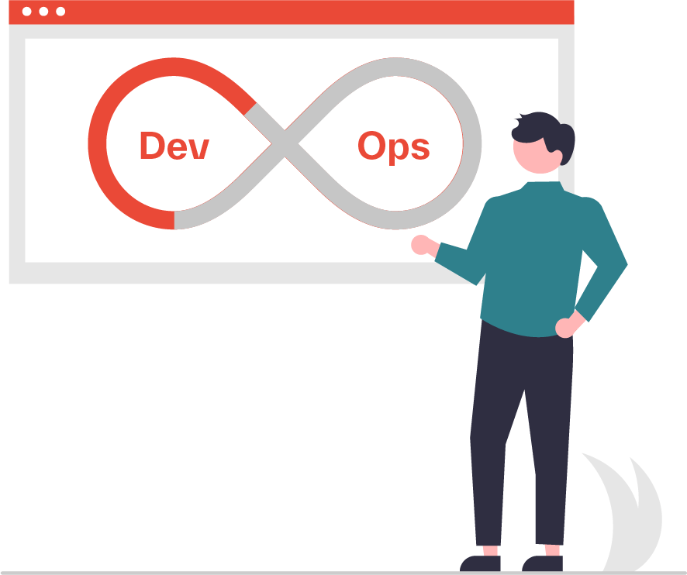
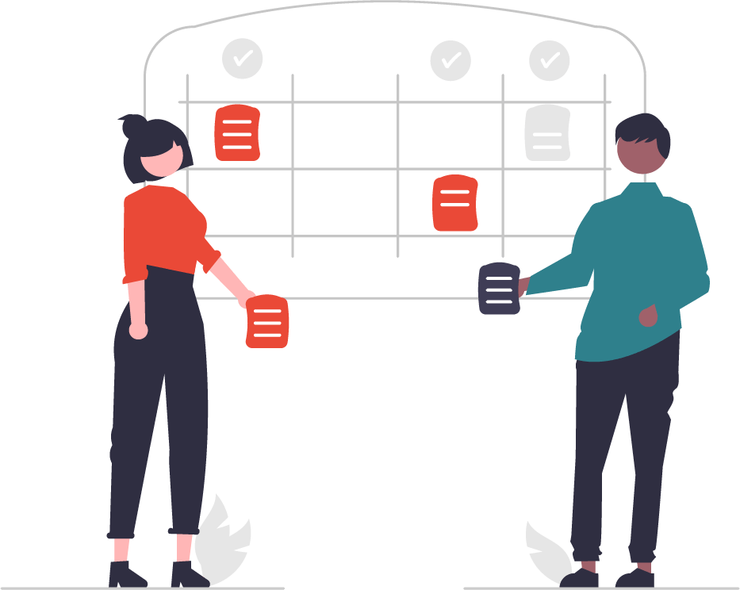


EcoVision can be an integral part of Kyndryl’s ESG Strategy
People
Our experts identify where customer is on their transformation journey, and we help chart the path forward
Automate & Optimize
Cloud operations
Cloud Ops
Unified
Observability
AIOps
Optimize
Cloud costs
FinOps
Ensure Compliance & Security
CompSecOps
Process
We leverage our proven processes and assets to design and build solutions for customer transformation
+
Technology
We iteratively deploy and operate innovative technology and services to help customer sustain the transformed state
DevSecOps
Accelerate
Release cycles
Orchestrate
Deployments
Achieve
Net-Zero
SustainabilityOps
Streamline
Governance
Modern Multisourcing

Slide 14


EcoVision Roadmap
EcoOps
Include Memory & I/O emissions
POC Implementation / MVP Client
Incorporate AI/ML / GenAI Models

Slide 15












Internal Developer Platform
Plan
Code
Verify
Stage
Deploy
Operate
Observe
Backlog
Code Libraries
Testing
App Control Plane
App Logging
Unit/Functional
Infra Targeting
Monitoring
Application
App IDEs
Integration
Deploy Strategy
App Automation
Microgenerator
Performance
App Image Registry
Deploy Intel
Incident Mgmt
App Monitoring
Security
IDP GUI
Continuous Integration (CI)
ITSM
Software-Based Operators
Agile Planning
Source Code Mgmt (SCM)
Code Compile, IaC Plan
Requirement Specifications
Continuous Delivery (CD)
On Demand Env.
Infra Manifest Registry
Infra Monitoring
Infra IDEs
Microgenerator
Disaster Recovery
K8s/Services
Incident Mgmt
Infrastructure
Shakedown
On Premise
Recovery
Infrastructure as Code (IaC)
Security
Cloud Provider
Monitoring
Infra Logging
Backlog
Testing
Kyndryl Bridge
15
Notes:
Illustrate the missing pieces from AS-IS

Slide 16
EcoVision –Data gathering and Carbon Saving Calculation (Sample Flow)
Secret Scan
Static Scan
Unit Test
Build
Image Scan
License Check
Deploy
Sever Config
300 Watts
(4core/16 GB)
300 Watts
(4core/16 GB)
300 Watts
(4core/16 GB)
300 Watts
(4core/16 GB)
300 Watts
(4core/16 GB)
300 Watts
(4core/16 GB)
300 Watts
(4core/16 GB)
Avg CPU Util
50%
50%
50%
50%
50%
50%
50%
Uptime/ Runtime
5 sec
24 sec
31 sec
16 sec
10 sec
31 sec
10 sec
Energy Consumption
2250
7200
4500
13950
4500
2250
10800
13950
4500
13950
10800
13950
7200
4500
Operational Emission = Estimated kwh * Emission Factor
Energy Consumption
(Estimated kwh)
Run 0 – 57150
Run 1 – 25650 (4/8 stages skipped)
Run 2 – 44100 (2/8 stages skipped)
Estimated kwh = Compute Watt-Hours * PUE( constant 1.5) * Replication Factor (1)
Compute Watt-Hours = Average Watts * Uptime or Time taken to execute the specific pipeline stage
Average Watts = Based Server Config (Hyper scalar vendor provided data can be considered)
Total CO2e = Operational Emissions + Embodied Emissions
Operational emissions = Compute emission + Memory emission + I/O emission
Average Watts = Derived based on server config and average CPU utilization Compute Watt-Hours = Average Watts * CPU Hours (uptime) Estimated kwh = compute Watt hours * PUE * replication factor Operational emissions = Estimated kwh * Emission factor
PUE = consider as 1.5 for now Replication factor = consider it as 1 Emission factor = based on region
CPU Hours = assume its 24 (in general) Avg Watts = Based on Avg CPU Util & Server Config Memory and I/O emission - ignore for now

Slide 17
Add quote or statement here
- Name Last
EcoVision - Phase 1

Slide 18

Team Members
Name | Email Address | Location | Current Role | Hackathon Role | Practice
Adrianna Kocyba-Kostecka | adrianna.kocyba-kostecka@kyndryl.com | Poland | Senior Project Manager | Governance | Global Cloud
BhavyaShree Mucherla | bhavyashree.mucherla@kyndryl.com | India | Ux – Design Lead | Visual Innovator | Cross-Practice
Chandan Bhat | Chandan.Bhat@kyndryl.com | India | Ux – Design Lead | Visual Innovator | Cross-Practice
Kannika Kabilar | kannika.kabilar@kyndryl.com | Canada | Developer - Software Engineering | Developers | Cloud
Kavya Singh | kavya.singh@kyndryl.com | India | Developer - Software Engineering | Developer | Cloud
Pedro Soares | pedro.soares@kyndryl.com | Portugal | Architect | Review & Advancement | Cloud
Praveen Kumar Madhava Rao | praveenmadhava@kyndryl.com | Czech Republic | Lead Cloud Architect | Team Lead | Strategic Market – Cloud
Prema Vivekanandan | prema.vivekanandan@kyndryl.com | United States | Global Delivery Architect – Zero Trust, Offering & Consult | EcoVision Designer | Global S&R
Sasikala Palanisamy | sasikala.palanisamy@kyndryl.com | India | Offering Architect | Backup of Vidya/ Design Lead | Global Cloud
Vidyasree Bharathwaj | vidyasree.bharathwaj@kyndryl.com | India | Offering Manager - AWS | Design Lead | Global Cloud
Provide/explain the architecture of the innovation either in an architectural diagram or flow chart plus relevant details in text

Slide 19

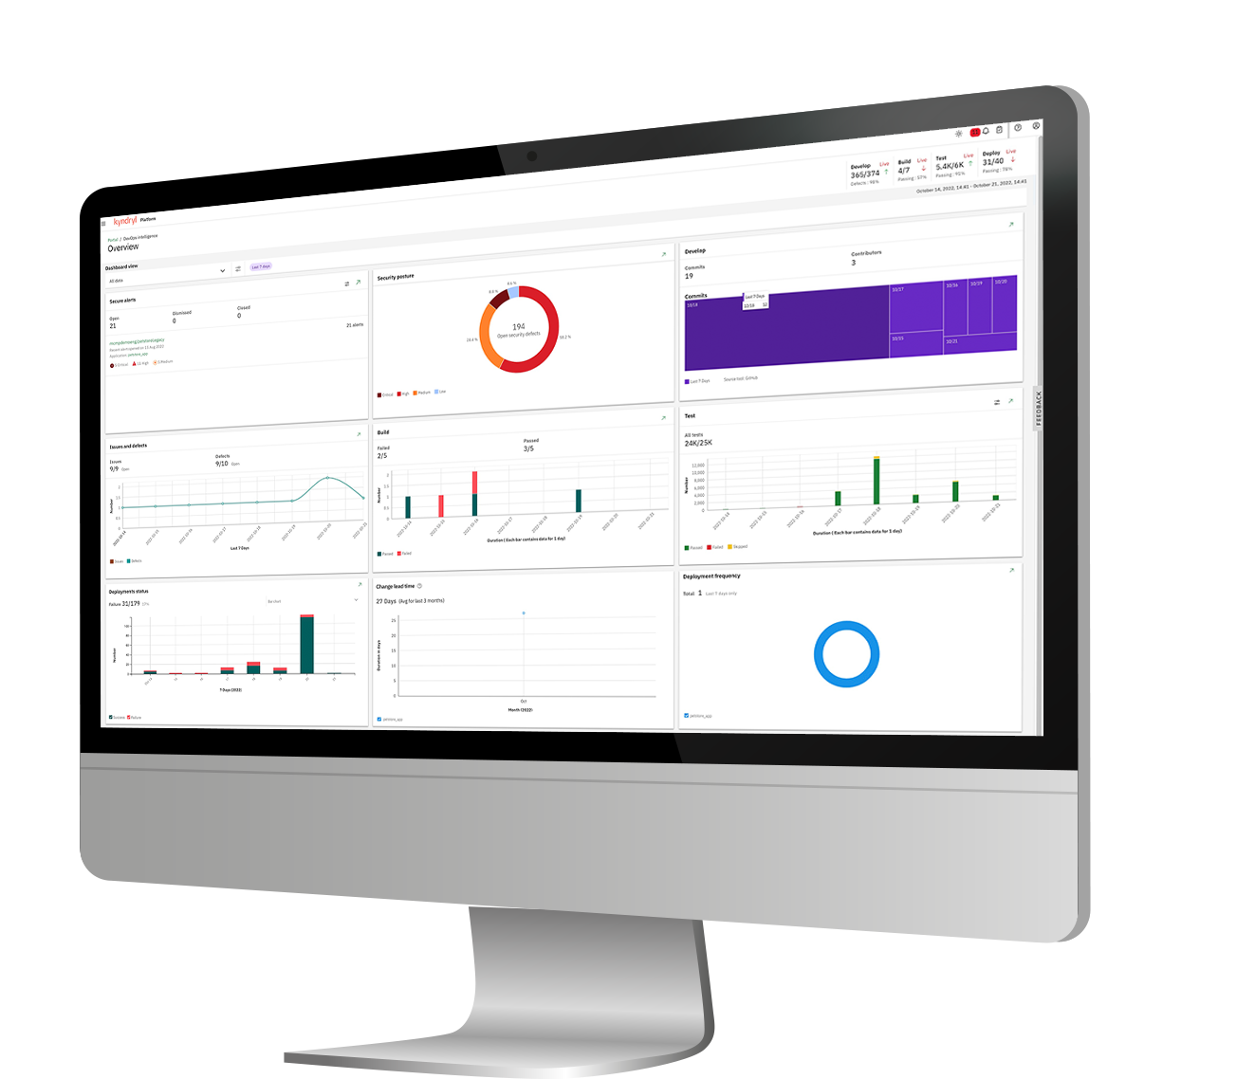






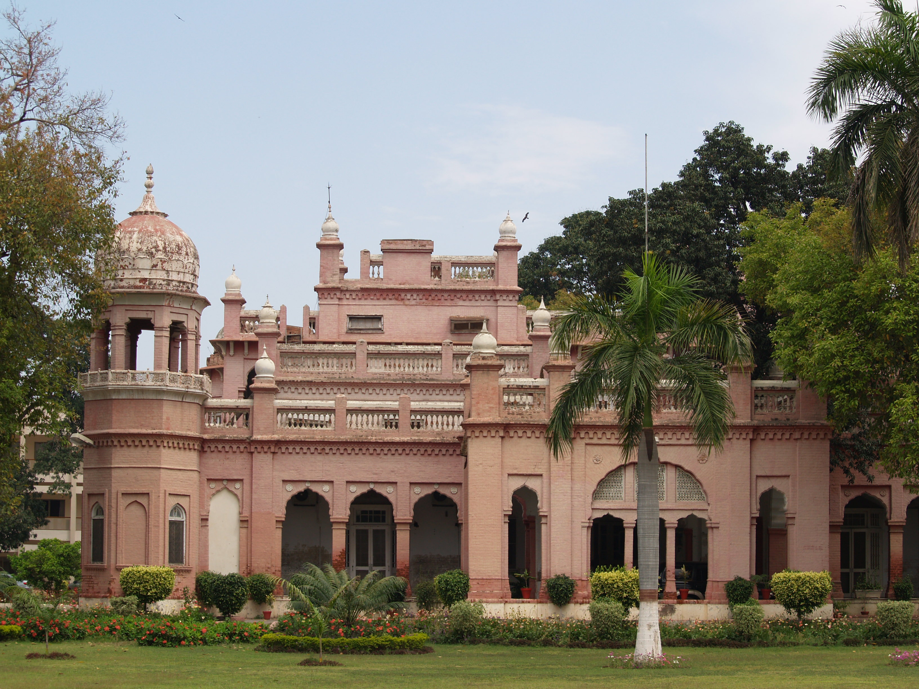

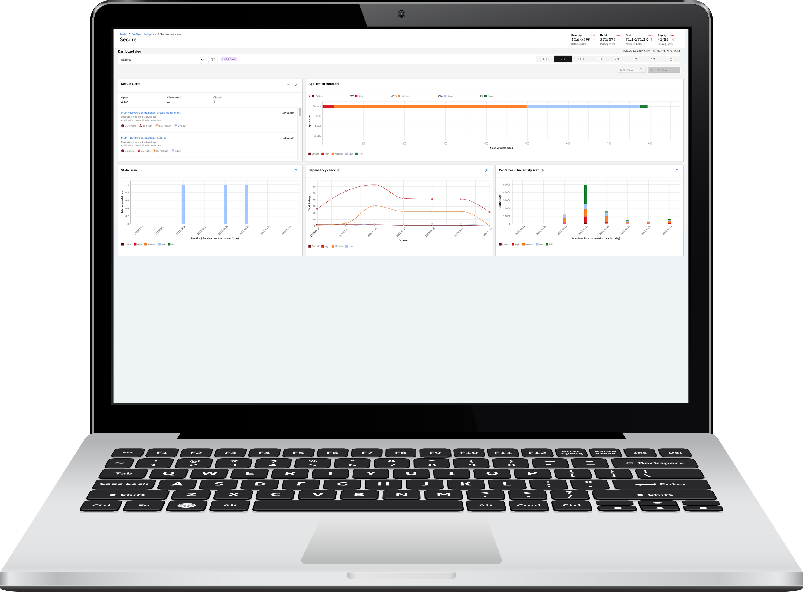

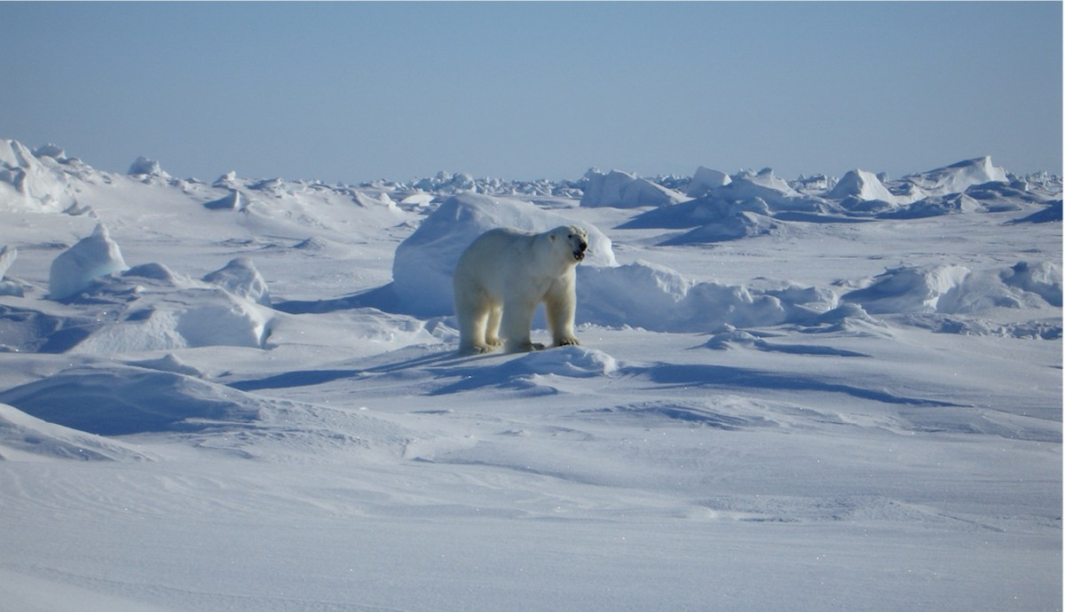



EcoVision – Theme #1
EcoVision’s goal is to create a solution to measure the carbon footprint of the software we are building to enable developers to write more efficient code. This capability can be easily integrated into the CI/CD pipeline to continuously measure and reduce the environmental impact of our code.
Functionality
Configurations
Time-to-market
Compliance
Performance
Feature Spotlight
DORA engine
Dynamic Runtime Analysis
Pre-trained AI/ML / Foundation Models based on LLM
ESG?
Alerts
Vulnerabilities
Multidomain Expertise
Seamless CI/CD Integration
Security categories
Visual Analytics
This Photo by Unknown Author is licensed under CC BY-SA

Slide 20

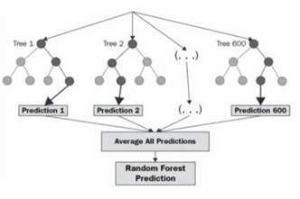

Solution Workflow
ABC Software Company is developing an e-commerce platform to meet customer demands. They aim to optimize CPU-intensive tasks like image processing for product thumbnails to reduce environmental impact while maintaining functionality
Build and Deployment Process
Run Time Profiling
Real Time monitoring
Performance counter increment ESG by 1
Insert probes/hooks
Collect method execution times,
Memory allocations,
Disk I/O and CPU utilization data
CPU Utilization
Memory Allocation
Disk I/O
Network Activity
Visualize
Dynamic Runtime Analysis
Yes
Optimization Recommendation
Yes
Implement and Validate
Programmer
acknowledge
Carbon Footprint Prediction
No
Continuous Improvement
Reevaluation / Continuation of code monitoring
Telemetry Data

Slide 21

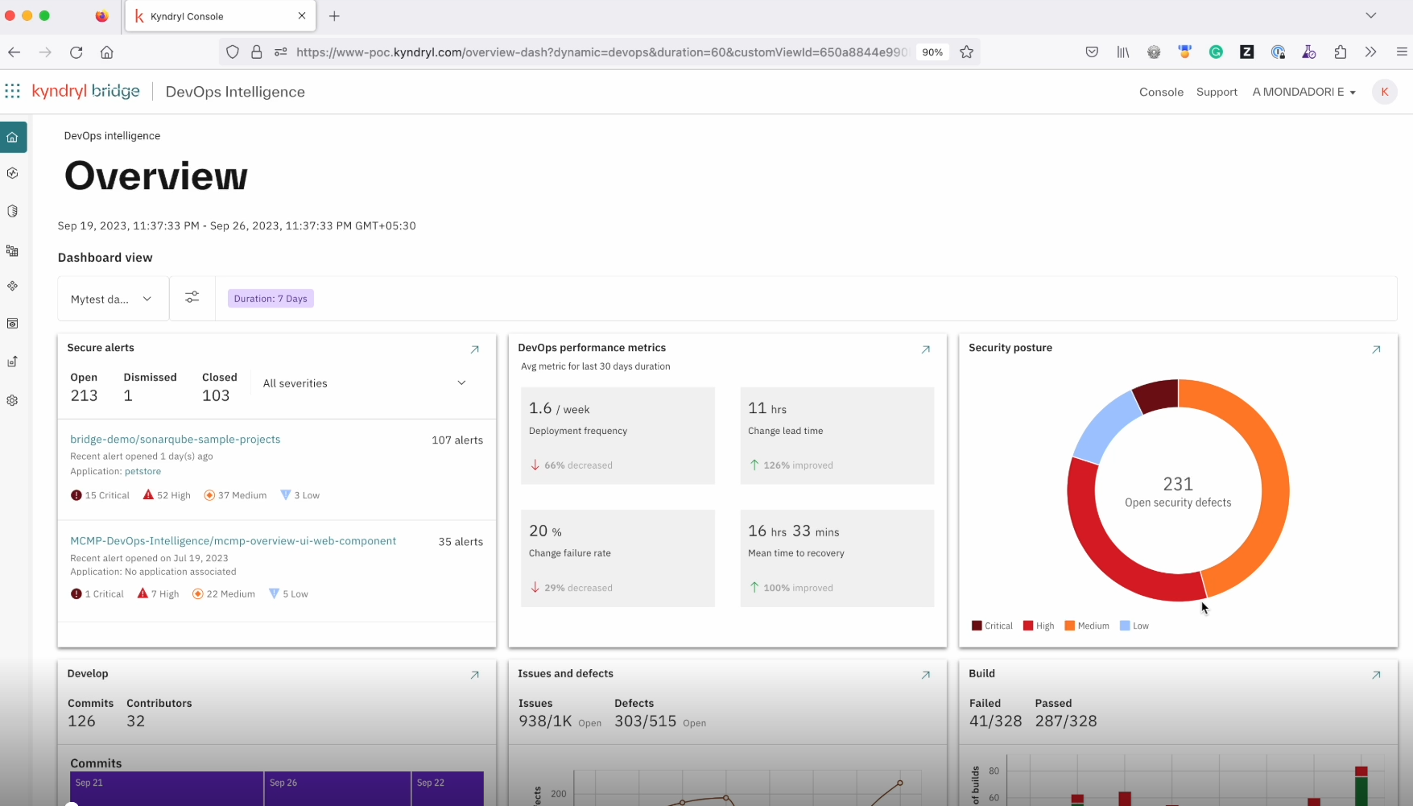

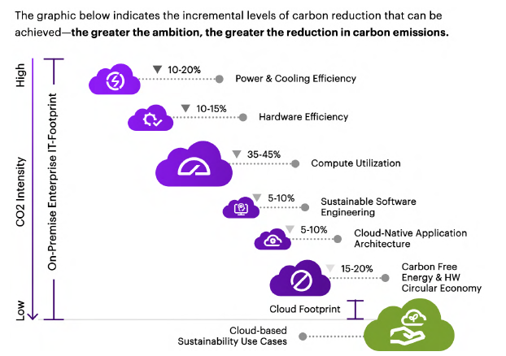






EcoVision Value Prop
How Green coding is considered a pivotal accelerator for Sustainability Initiatives
EcoVision Insights
Parallelization: This can significantly speed up the training process and reduce the time and energy required for model training.
Early Stopping: Implement early stopping criteria during training to halt the process when the model's performance no longer improves
Energy-Efficient Hardware: Deploy EcoVision on energy-efficient hardware infrastructure, such as servers with low-power processors or GPUs optimized for machine learning workloads.
Integration: into Kyndryl Developer Services to meet Kyndryl’s Sustainability goals

Slide 22

EcoVision – Team Synergy
Empowering Team Success
New skills
Learnt about Sustainability offering within Kyndryl
Random Forest Regression
FIGMA
Team Work
Interdisciplinary teams – diverse skills from Design, Architect , Offering, Engineering and Development, Project Management
Cross Practice -Global S&R, Global & SM Cloud
TimeZone and Cultural differences – US, Europe and AP
Share Communication Platforms – Teams, Mural, O365

Slide 23
Working Demo – Phase 1

Slide 24
Thank You
Date Mar 11, 2024

